Slide 1
What is React?
A Library for Building Dynamic User Interfaces
Notes:
“Today I’ll walk through React from the ground up. We’ll cover what it is, why it’s useful, how it works, and how modern React development looks today.”
“By the end, you should understand the core ideas behind React and how the ecosystem has evolved.”

Slide 2
The Formal Definition
Created By: Meta (formerly Facebook) in 2013.
Core Purpose: An open-source JavaScript library (not a framework!) for building user interfaces, specifically for Single-Page Applications (SPAs).
Market Position: The most popular UI library in the world, used by Netflix, Airbnb, and Instagram.
Notes:
“React was created by Meta in 2013 and is an open-source JavaScript library for building user interfaces. It is especially popular for single-page applications, where the UI changes without full page reloads.”
“React is widely used because it helps teams build interfaces that are easier to scale and maintain.” Notes

Slide 3
Declarative vs. Imperative
Imperative (The Hard Way): Manually manipulating every DOM element (e.g., jQuery). You tell the browser how to do it.
Declarative (The React Way): You describe what you want the UI to look like based on the data. React handles the "how."
Benefit: Code is more predictable, easier to test, and significantly less buggy.
Notes:
“The big React mindset shift is moving from imperative to declarative code. In the imperative style, you manually tell the browser every step to take.”
“With React, you describe what the UI should look like, and React handles the updates. That makes code more predictable and usually easier to debug.”

Slide 4
Imperative vs Declarative
// Imperative (Step by Step)
const numbers = [1, 2, 3];
const doubled = [];
for (let i = 0; i < numbers.length; i++) {
const result = numbers[i] * 2;
doubled.push(result);
}
console.log(doubled); // [2, 4, 6]
// Declarative (Result Oriented)
const numbers = [1, 2, 3];
const doubled = numbers.map(n => n * 2);
console.log(doubled); // [2, 4, 6]

Slide 5
Imperative vs Declarative
// Imperative (Vanilla JS)
const btn = document.querySelector('#toggleBtn');
btn.addEventListener('click', () => {
if (btn.classList.contains('active')) {
btn.classList.remove('active');
btn.textContent = 'Inactive';
btn.style.backgroundColor = 'red';
} else {
btn.classList.add('active');
btn.textContent = 'Active';
btn.style.backgroundColor = 'green';
}
});
// Declarative (React)
function ToggleButton() {
const [isActive, setIsActive] = useState(false);
return (
<button
onClick={() => setIsActive(!isActive)}
style={{ backgroundColor: isActive ? 'green' : 'red' }}
>
{isActive ? 'Active' : 'Inactive'}
</button>
);
}

Slide 6
Component-Based Architecture
The "Lego" Strategy: Interfaces are broken down into small, isolated pieces of code called Components.
Independent: A bug in the "Search Bar" component won't necessarily break the "Video Player" component.
Reusable: Build a CustomButton once; use it across 50 different pages.
Notes:
“React breaks the UI into components, which are small, reusable pieces of interface. This makes large applications easier to organize because each part has a clear responsibility.”
“The best way to think about it is like Lego blocks: build once, reuse often, and keep each piece isolated.”

Slide 7
The Evolutionary Shift: Class vs. Function
Class Components (The History): * Relies on OOP and the this keyword.
  Logic is split by time (Lifecycle methods).
Function Components (The Modern Standard): * Uses Hooks (introduced in React 16.8).
  Logic is grouped by purpose, making it more concise and readable.
Notes:
“Older React code often uses class components, which rely on the this keyword and lifecycle methods. Modern React mostly uses function components because they are simpler and more concise.”
“Hooks made function components powerful enough to handle state and side effects, so they became the standard approach.”

Slide 8
Lifecycle vs. Effects
The Manual Way (Class): You must manually compare prevState to this.state in componentDidUpdate to avoid infinite loops.
The Automated Way (Functions): The Dependency Array in useEffect (e.g., [count]) manages comparisons automatically.
Result: Reduced boilerplate and fewer side-effect bugs.
Notes:
“In class components, lifecycle logic is spread across different methods, which can make it harder to follow. In function components, useEffect groups side-effect logic in one place.”
“The dependency array controls when the effect should run, which reduces boilerplate and makes the behavior easier to reason about.”

Slide 9
The Power of JSX
What is it? JavaScript XML. It looks like HTML but lives inside your JavaScript.
Why use it? It allows you to keep your logic (JS) and your layout (HTML) in the same file.
Transformation: Browsers can't read JSX; tools like Babel or Vite compile it into standard JavaScript objects.
Notes:
“JSX stands for JavaScript XML. It looks like HTML, but it lives inside JavaScript, which lets you keep structure and logic close together.”
“React does not send JSX directly to the browser. Tools like Vite or Babel transform it into regular JavaScript that the browser can understand.”

Slide 10
The Virtual DOM
The Problem: Updating the real browser DOM is slow and expensive.
The Solution: React keeps a "Virtual" copy in memory.
The "Diffing" Process:
  Data changes.
  React creates a new Virtual DOM.
  It compares the new one with the old one (Diffing).
  It updates only the changed parts in the real DOM.
Notes:
“One of React’s key ideas is the virtual DOM, which is a lightweight in-memory representation of the real DOM. When data changes, React creates a new virtual tree and compares it with the old one.”
“Only the changed parts are applied to the real DOM, which improves performance and helps React stay efficient at scale.”

Slide 11
Unidirectional Data Flow
One-Way Street: Data moves from parent components down to child components via Props.
Predictability: This makes it easy to track where data is coming from and where it is going.
State Management: Components manage their own data locally using Hooks (like useState).
Notes:
“React uses one-way data flow, which means data moves from parent components down to child components through props. That makes it easier to trace where data comes from and how it changes.”
“State is usually managed locally inside the component unless you need to lift it up or share it more broadly.”

Slide 12
The Ecosystem
React Native: Use the same logic to build mobile apps for iOS and Android.
Community: Thousands of third-party libraries for routing (React Router), styling (Tailwind/Styled Components), and state (Redux/Zustand).
Tooling: Modern project scaffolding with Vite provides instant feedback via Hot Module Replacement (HMR).
Notes:
“React itself solves the UI layer, but the ecosystem around it handles everything else. React Native lets you use similar concepts for mobile apps, while tools like React Router, Redux, Zustand, Tailwind, and styled-components cover routing, state, and styling.”
“The ecosystem is one reason React remains such a strong choice for real-world applications.”

Slide 13
Modern React (React 19)
The React Compiler: Automates re-render optimizations, making manual useMemo largely a thing of the past.
Server Components: Renders logic on the server for faster initial page loads and better SEO.
New Hooks: Introduction of useOptimistic and useActionState for smoother user interactions.
Notes:
“Modern React keeps evolving. React 19 introduces features like server components, new hooks such as useOptimistic and useActionState, and compiler-based optimizations.”
“The main goal is to reduce manual performance tuning and improve both developer experience and app responsiveness.”

Slide 14
Modern Setup with Vite
The New Standard: Vite replaces Create React App (CRA) for faster, leaner development.
Instant Feedback: Uses Hot Module Replacement (HMR) to update the UI instantly without losing application state.
Scaffolding: npm create vite@latest creates a minimal project that is ready to scale.
Notes:
“Today, Vite is the preferred way to start a new React project. It is faster and lighter than older setups like Create React App, and it gives you a very fast development loop.”
“Hot Module Replacement means you can see changes instantly without losing state, which makes the feedback loop much smoother during development.”

Slide 15
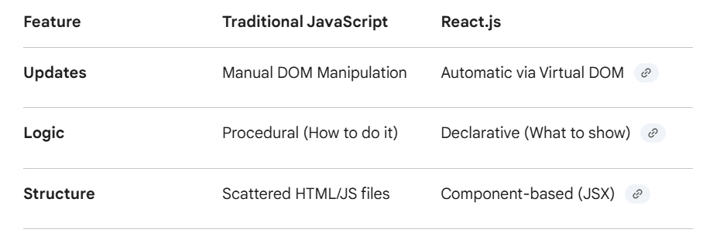

Slide 16
Summary – Why React?
Declarative: Describe the UI; React does the rest.
Component-Based: Build reusable "Lego" pieces.
Efficient: Virtual DOM ensures high performance.
Vibrant: Massive job market and community support.
Question: Are you ready to build your first component
Notes:
“To summarize, React is popular because it is declarative, component-based, and efficient. Its ecosystem is large, and modern tooling like Vite makes it fast to work with.”
“The core idea is simple: describe the UI, and let React handle the updates.”

